Slide 1
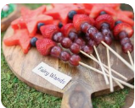
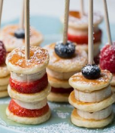
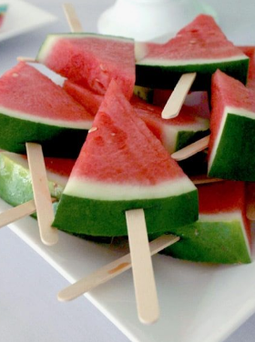
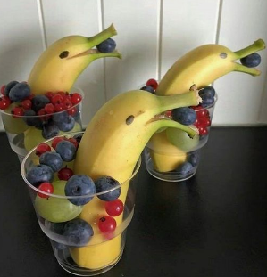
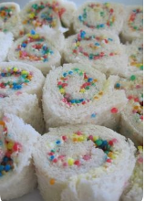
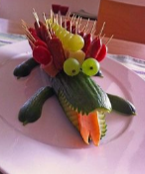
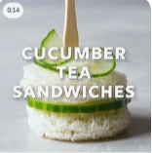
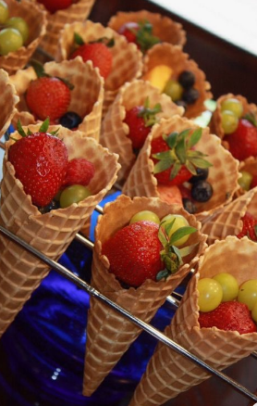
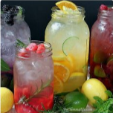
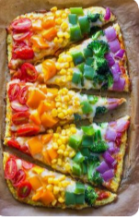
You've made it!
Goodbye Year 2!
Hello Year 3!
Have a go at making some fun foods and have a party at home, in the park, face time your friends and family. Have a great time you deserve it! Remember Stay safe.
https://www.youtube.com/watch?v=qB1bkkCidZo

Slide 2
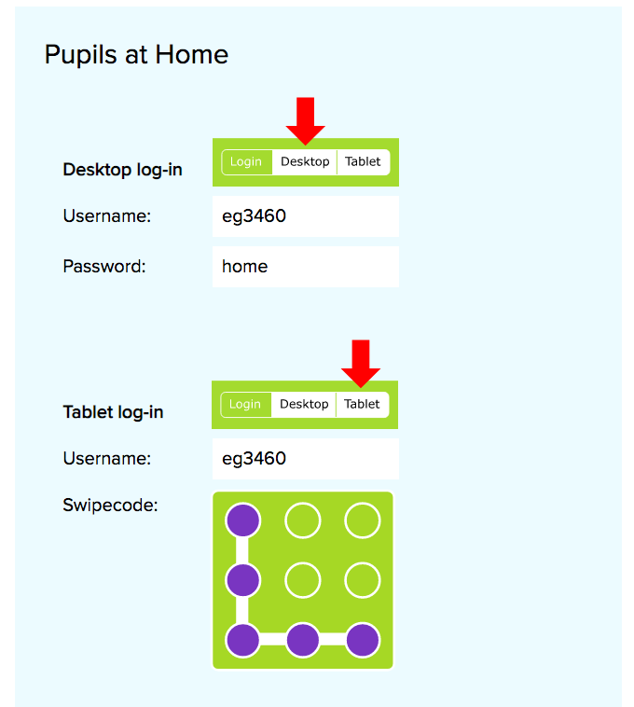
You can now access our handwriting scheme of work online. Your log-in details are below.
Click your class to find out what we have set you.
https://www.letterjoin.co.uk/log-in.html

Slide 3
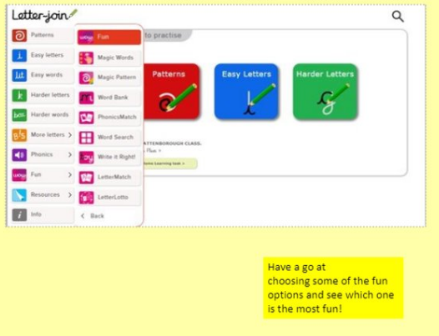
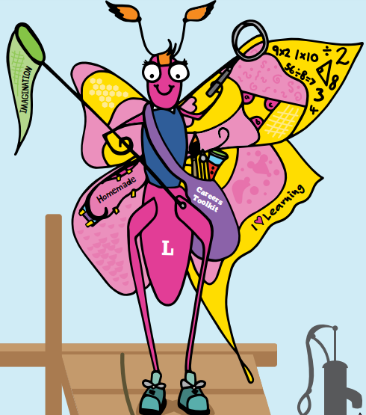

Slide 4
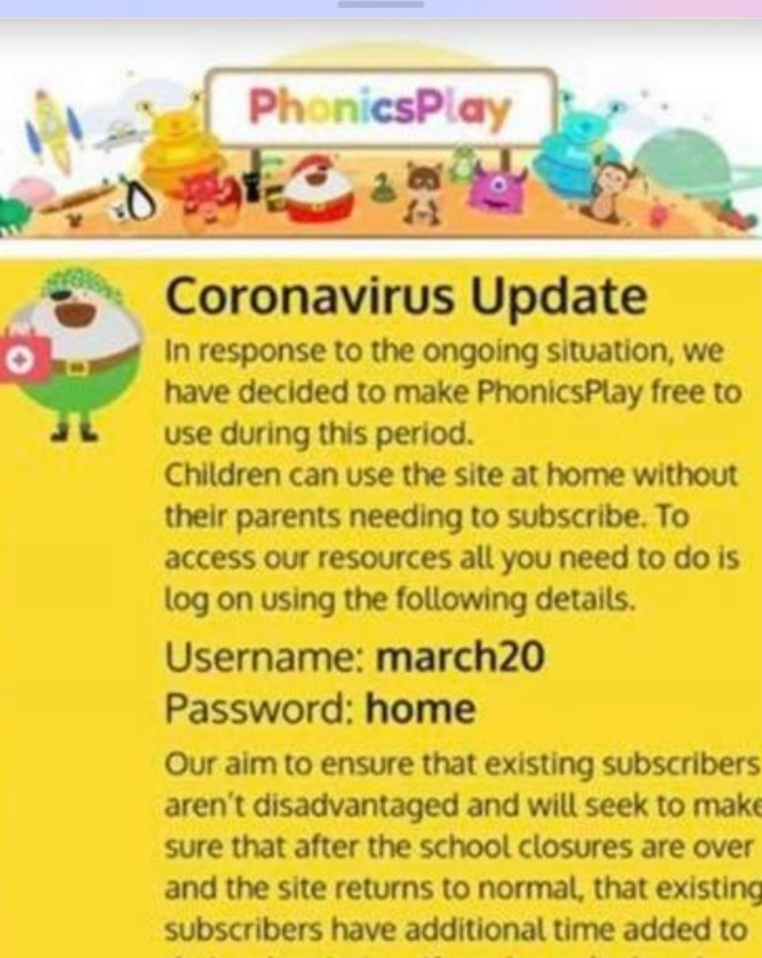
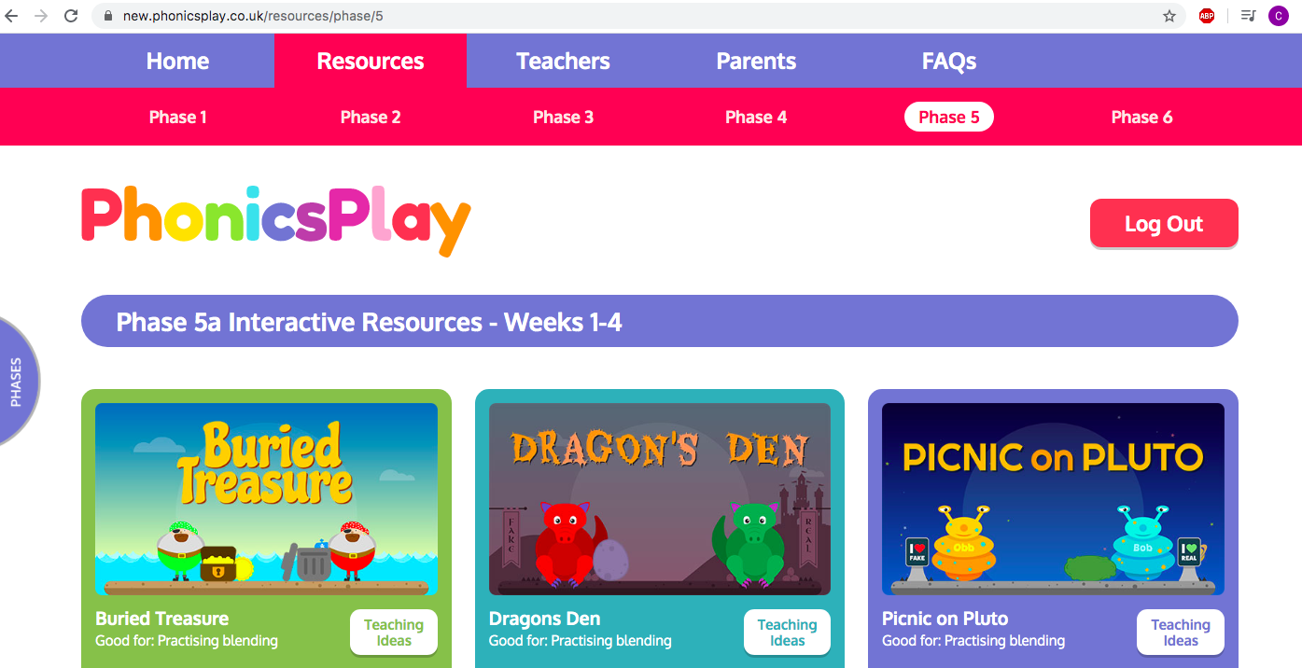
We will not be providing phonics lessons for Year 2 for the Summer term and focussing on Destination Reader to help improve our reading comprehension skills.
If you are in Pippa, Miss Hughes or Mel’s group please have a look at their phonics lessons under Year 1.
If you would like to start your learning with a quick phonics practice, go onto Phonics Play with the log in here
And play a phonics game.
https://new.phonicsplay.co.uk/

Slide 5
Destination Reader
Let’s recap… Asking questions.

Slide 6
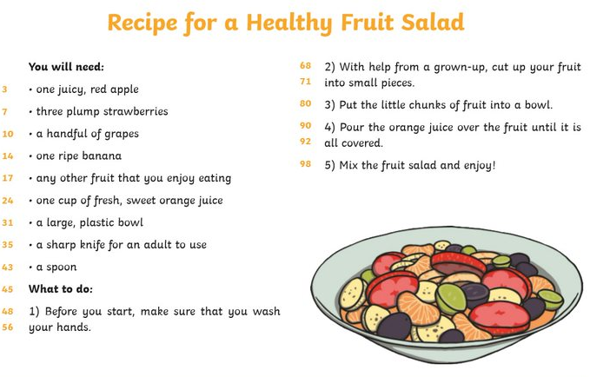
Today is comprehension day.

Slide 7
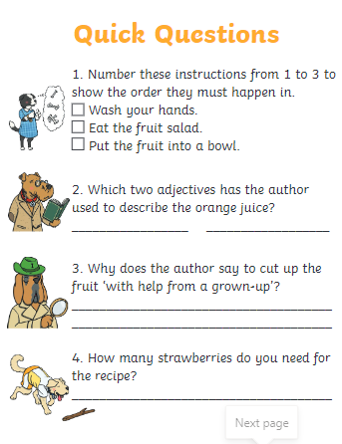
Today is comprehension day

Slide 8
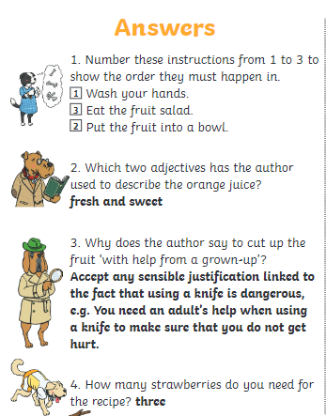
Today is comprehension day

Slide 9
English
Last week we used our own ideas to re-write parts of the text!
Follow this link to hear the story ready by the author!
https://www.youtube.com/watch?v=k965-YGcL4I

Slide 10
This week we are to use all of our plans from last week to re-write the story!
Today we have going to focus on the last two characters!

Slide 11
The ending…
See if can edit the ending to the story… the yellow boxes are the name and the blue boxes are the adjective that you used in your title.
My example…
Rachel?
What?
Flowery Rachel?
Yes, Flowery Rachel’s extra ordinary deed had come full circle, and on its way it had changed the lives of every person living!

Slide 12
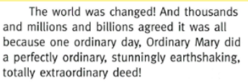
The ending…
Read back over the ending of the story….
How could you change this to make it your ending? I will give you a clue maybe you could change the adjectives?
Now you need to read through all of your work and check it makes sense! You should now have your very own story!! Well done ☺

Slide 13
The next 4 characters
All week 13th – 17th July 2020 LO – I can invent a story.
Uni | Multi | Relational | Extended
* use an adjective in your title to describe your main character. | * Use your adjective from your title to write about your main character in the beginning of your story. | * use adjectives, similes and alliteration in order to make your descriptions more interesting. | Link all of your character’s good deeds back to your main character and end your story.
Toolkit – A . ! , ‘
Keep going you can do this ☺

Slide 14
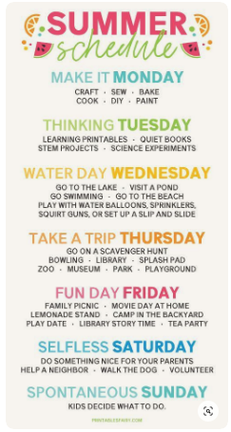
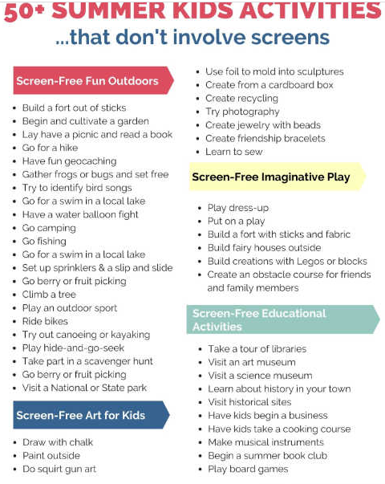
OK you have made it! Today I would like you to do two things.
1. Get a piece of paper and with a family member write a list of things you would like to do this summer. It can be dipping your toes in the sea or go to the local park and play with your friends. Some things we still can't do but write it down and it might happen later. I would love to see your lists!
2. Get all the yummy food you can and have a great party with your family, face time your friends and get them to join you!

